Slide 1



Lecture six(Reflection and refraction at spherical surfaces
Dr. Sabah Ibrahim Abbas Al-Karkh University
college of Sciences –Medical physics department

Slide 2

Lecture six(Reflection and refraction at
spherical surfaces
In this chapter, we will treat refractive of light at a single spherical separating two media of different refractive indices, where a beam of light passes from one (𝑛₁) medium into another (𝑛₂). In all diagrams the incident light rays traveling from left to right. A convex surface therefore is one in which the center of curvature C lies to the right of the vertex, while a concave surface is one in which C lies to the left of the vertex as shown in figure.

Slide 3






















Lecture six(Reflection and refraction at spherical surfaces
(a)
(b)
1
₂
₁
R
₂
R
F
A
C
A
C
R
R
(c )
(d)
₁
₂
₁
₂
R
c
A
c
A
R
R

Slide 4
Lecture six(Reflection and refraction at
spherical surfaces
It is possible to observe the following points from the figure:
The principal axis in each diagram is straight line passes through the center of curvature C.
The point A where the axis crosses the surface is called the vertex.
In diagram (a) rays are shown diverging from a point source F on the axis in the first medium and refracted into a beam everywhere parallel to the axis in the second medium.
Diagram (d) shows a beam converging in the first medium toward the point F and then refracted into a parallel beam in the second medium. F in each of these two cases is called the primary focal point, and the distance f is called the primary focal length.

Slide 5

Lecture six(Reflection and refraction at
spherical surfaces
In diagram (b) a parallel incident beam is refracted and brought to a
focus at the point F'.
In diagram (C) a parallel incident beam is refracted to diverge as if it came from the point F'. F' in each case is called the secondary focal point and the distance f ' is called the secondary focal length.
We now state that the primary focal point F is an axial point having the property that any ray coming from it or proceeding toward it travels parallel to the axis after refraction.
the similar statement that the secondary focal point F' is an axial point having the property that any incident ray traveling parallel to the axis will, after refraction, proceed toward, or appear to come from, F'.
A plane perpendicular to the axis and passing through either focal
point is called a focal plane.

Slide 6



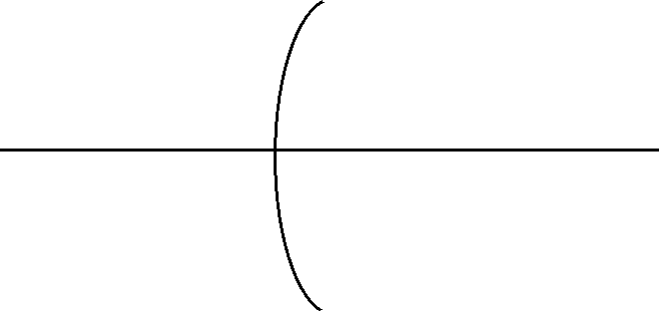













Lecture six(Reflection and refraction at spherical surfaces
GRAPHICAL CONSTRUCTIONS. THE PARALLEL-RAY METHOD
They apply only to images formed by paraxial rays. For such rays the refraction occurs at or very near the vertex of the spherical.
Q
y
C
M
F
y’
f
f ‘
S
S’

Slide 7

Lecture six(Reflection and refraction at
spherical surfaces
OBLIQUE-RAY METHODS
In more complicated optical systems that are treated in the following chapters it is convenient to be able graphically to trace a ray across a spherical boundary for any given angle of incidence. In these constructions one is free to choose any two rays coming from a common object point and, after tracing them through the system, find where they finally intersect. This intersection is then the image point.

Slide 8














Lecture six(Reflection and refraction at
spherical surfaces
K
n
Z
M
F
A
c
O
s

Slide 9

Lecture six(Reflection and refraction at
spherical surfaces
Derivation of the Gaussian formula
The Gaussian formula is general method that may be employed to determine the position and size of the image. A method involving oblique rays used for derivation the Gaussian formula, an oblique ray from an axial object point M is shown incident on the surface at an angle 𝜑 and refracted at an angle𝜑 . The refracted ray crosses the axis at the image point 𝑀 . If the incident and refracted rays MB and BM' are paraxial, the angles 𝜑 and 𝜑 will be small.

Slide 10


















Lecture six(Reflection and refraction at
spherical surfaces
B
n
h
M
u
A
S
C
R
s

Slide 11
Lecture six(Reflection and refraction at
spherical surfaces
In triangle (MBC) where 𝜑 is external angle:
𝜑 = 𝜃 + 𝑢 −−−− −(1)
Since 𝜑 is an external angle for the triangle MBC and equal the sum of the opposite interior angles
𝜃 = 𝜑 + 𝑢′
𝜑 = 𝜃 − 𝑢 −−− −(2)
Using Snell’s law at B point
𝑛 𝑠𝑖𝑛 𝜑
= 𝑛 sin 𝜑′ 𝑓𝑜𝑟 𝑠𝑚𝑎𝑙𝑙 𝑎𝑛𝑔𝑙𝑒𝑠 (sin 𝜑 = 𝜑)

Slide 12
Lecture six(Reflection and refraction at
spherical surfaces
n φ = n 𝜑′
𝑛 𝜃 + 𝑢 = 𝑛 𝜃 − 𝑢
𝑛𝑢 + 𝑛 𝑢 = (𝑛 − 𝑛)𝜃
From ∆ 𝑀𝐵𝑆 , Angle values are
Substitute these values in the last equation and obtain
𝑛 ^{ℎ} + 𝑛 ^{ℎ} = (𝑛′ − 𝑛) ^{ℎ}
𝑠 𝑠
𝑅
𝐺𝑎𝑢𝑠𝑠𝑖𝑎𝑛 𝑓𝑜𝑟𝑚𝑢𝑙𝑎
𝑛 ₊ 𝑛′ ₌ 𝑛′−𝑛
•
𝑠 𝑠 𝑅

Slide 13
Lecture six(Reflection and refraction at
spherical surfaces
Magnification image in spherical surfaces
In any optical system the lateral magnification is known as the ratio between the transverse dimension of the final image and corresponding dimension of the original object.
_{𝑀 =} 𝑦
•
𝑦

Slide 14
Lecture six(Reflection and refraction at
spherical surfaces
𝑀𝑎𝑔𝑛𝑖𝑓𝑖𝑐𝑎𝑡𝑖𝑜𝑛 = 𝑀 = ^{𝑦′} = − ^{𝑛𝑠′}
𝑦
Miniature image.
Magnification image.
𝑛′𝑠
If M <1
If M >1
M=1 object and image the same size.
If M is positive the image will be virtual and erect.
If M is negative the image is real and invert.
The refracting power (P) when all distance are measured in meter and the power unit is called diopters is given by equation
_{𝑃 =} 𝑛 ₌ 𝑛′ ₌ 𝑛′−𝑛
_{𝑓}′
𝑓 𝑅

